Slide 1
Cryptography and Network Security
PRIME NUMBERS
Fermat’s & Euler’s theorem
Testing for primality
Chinese Remainder theorem
Discrete logarithms

Slide 2
Session Meta Data
Author | Dr T Sree Sharmila
Reviewer
Version Number | 1.0
Release Date | 30 June 2018

Slide 3
Revision History
Revision Date | Details | Version no.
 |  | 1.0

Slide 4
Agenda
Introduction
Primes
Definition
Cardinality of Primes
Checking for Primeness
Euler’s Phi-Function
Fermat’s Little Theorem
Euler’s Theorem
Generating Primes
Modular arithmetic
Groups
Rings
Fields
Finite field
Polynomial arithmetic
Summary
Test your understanding
References

Slide 5
Introduction
❏ To introduce prime numbers and their applications in cryptography.
❏ To discuss some primality test algorithms and their efficiencies.
❏ To discuss factorization algorithms and their applications in cryptography.
❏ To describe the Chinese remainder theorem and its application.
❏ To introduce quadratic congruence.
❏ To introduce modular exponentiation and logarithm.

Slide 6
PRIMES
Asymmetric-key cryptography uses primes extensively. The topic of primes is a large part of any book on number theory.

Slide 7
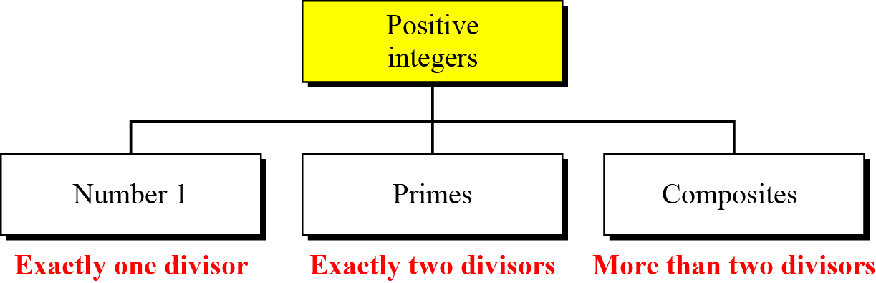

Definition
Three groups of positive integers
Note
A prime is divisible only by itself and 1.

Slide 8
Definition
Example 1
What is the smallest prime?
Solution
The smallest prime is 2, which is divisible by 2 (itself) and 1.
Example 2
List the primes smaller than 10.
Solution
There are four primes less than 10: 2, 3, 5, and 7. It is interesting to note that the percentage of primes in the range 1 to 10 is 40%. The percentage decreases as the range increases.

Slide 9
Cardinality of Primes
Infinite Number of Primes
Note
There is an infinite number of primes.
Number of Primes

Slide 10
Cardinality of Primes
Example 3
As a trivial example, assume that the only primes are in the set {2, 3, 5, 7, 11, 13, 17}. Here P = 510510 and P + 1 = 510511. However, 510511 = 19 × 97 × 277; none of these primes were in the
original list. Therefore, there are three primes greater than 17.
Example 4
Find the number of primes less than 1,000,000.
Solution
The approximation gives the range 72,383 to 78,543. The actual number of primes is 78,498.

Slide 11

Checking for Primeness
Given a number n, how can we determine if n is a prime? The answer is that we need to see if the number is divisible by all primes less than
We know that this method is inefficient, but it is a good start.

Slide 12
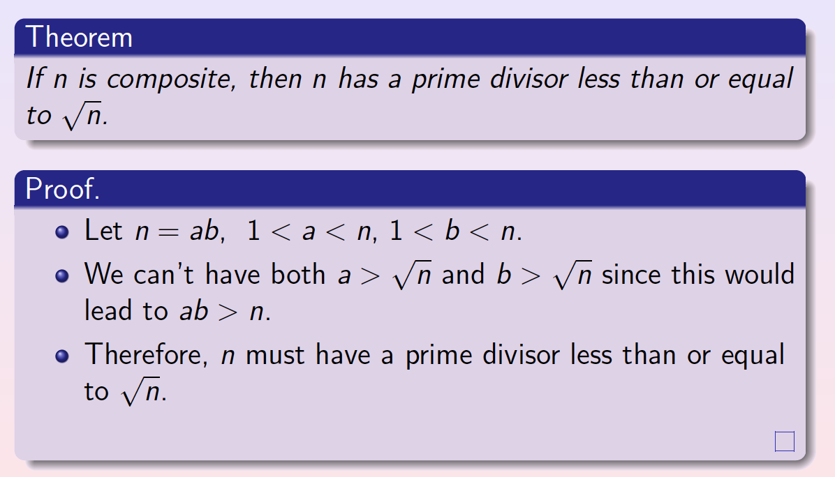
Checking for Primeness

Slide 13
Checking for Primeness
Example 9.5
Is 97 a prime?
Solution
The floor of √97 = 9. The primes less than 9 are 2, 3, 5, and 7. We need to see if 97 is divisible by any of these numbers. It is not, so 97 is a prime.
Example 9.6
Is 301 a prime?
Solution
The floor of √301 = 17. We need to check 2, 3, 5, 7, 11, 13, and 17. The numbers 2, 3, and 5 do not divide 301, but 7 does. Therefore 301 is not a prime.

Slide 14
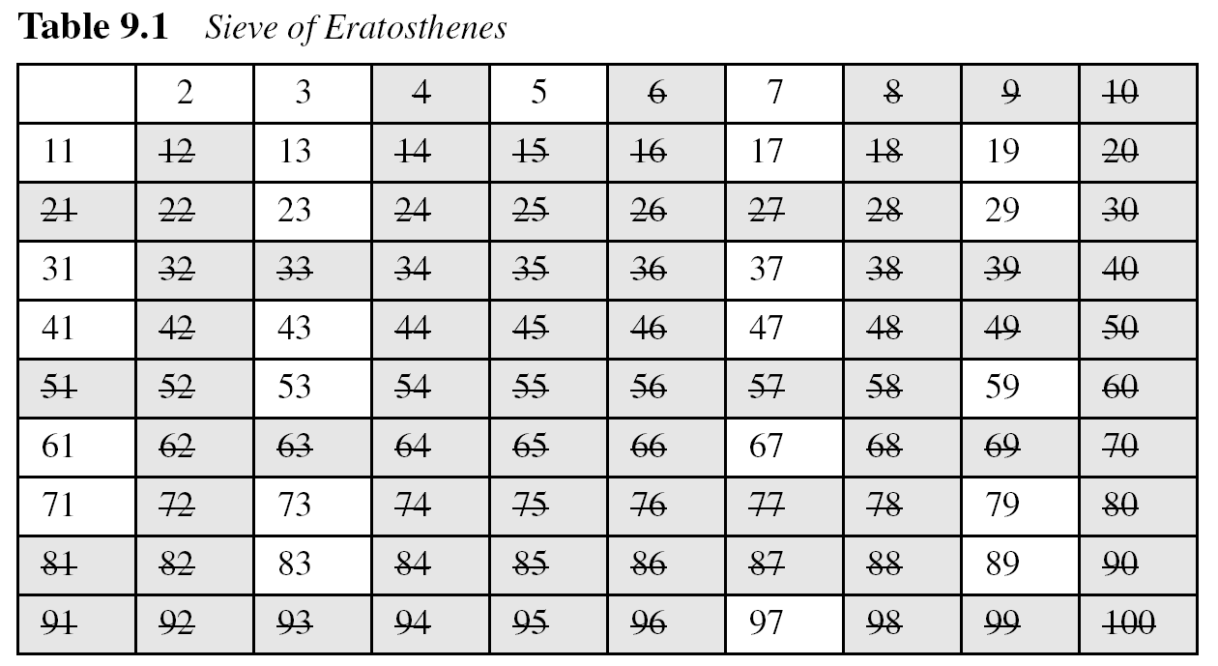
Checking for Primeness
Sieve of Eratosthenes

Slide 15
9.1.4 Euler’s Phi-Function
Euler’s phi-function, φ (n), which is sometimes called the
Euler’s totient function plays a very important role in cryptography.

Slide 16
9.1.4 Continued
We can combine the above four rules to find the value of φ(n). For example, if n can be factored as
n = p₁^{e1} × p₂^{e2} × … × p_{k}^{ek}
then we combine the third and the fourth rule to find
Note
The difficulty of finding φ(n) depends on the difficulty of finding the factorization of n.

Slide 17
9.1.4 Continued
Example 9.7
What is the value of φ(13)?
Solution
Because 13 is a prime, φ(13) = (13 −1) = 12.
Example 9.8
What is the value of φ(10)?
Solution
We can use the third rule: φ(10) = φ(2) × φ(5) = 1 × 4 = 4, because 2 and 5 are primes.

Slide 18
9.1.4 Continued
Example 9.9
What is the value of φ(240)?
Solution
We can write 240 = 2⁴ × 3¹ × 5¹. Then
φ(240) = (2⁴ −2³) × (3¹ − 3⁰) × (5¹ − 5⁰) = 64
Example 9.10
Can we say that φ(49) = φ(7) × φ(7) = 6 × 6 = 36?
Solution
No. The third rule applies when m and n are relatively prime. Here 49 = 7². We need to use the fourth rule: φ(49) = 7² − 7¹ = 42.

Slide 19
9.1.4 Continued
Example 9.11
What is the number of elements in Z₁₄*?
Solution
The answer is φ(14) = φ(7) × φ(2) = 6 × 1 = 6. The members are 1, 3, 5, 9, 11, and 13.
Note
Interesting point: If n > 2, the value of φ(n) is even.

Slide 20
9.1.5 Fermat’s Little Theorem
First Version
a^{p − 1} ≡ 1 mod p
Second Version
a^{p} ≡ a mod p

Slide 21
9.1.5 Continued
Example 9.12
Find the result of 6¹⁰ mod 11.
Solution
We have 6¹⁰ mod 11 = 1. This is the first version of Fermat’s little theorem where p = 11.
Example 9.13
Find the result of 3¹² mod 11.
Solution
Here the exponent (12) and the modulus (11) are not the same. With substitution this can be solved using Fermat’s little theorem.

Slide 22
9.1.5 Continued
Multiplicative Inverses
a⁻¹ mod p = a ^{p − 2} mod p
Example 9.14
The answers to multiplicative inverses modulo a prime can be found without using the extended Euclidean algorithm:

Slide 23
9.1.6 Euler’s Theorem
First Version
a^{φ(n)} ≡ 1 (mod n)
Second Version
a ^{k × φ(n) + 1} ≡ a (mod n)
Note
The second version of Euler’s theorem is used in the RSA cryptosystem in Chapter 10.

Slide 24
9.1.5 Continued
Example 9.15
Find the result of 6²⁴ mod 35.
Solution
We have 6²⁴ mod 35 = 6^{φ(35)} mod 35 = 1.
Example 9.16
Find the result of 20⁶² mod 77.
Solution
If we let k = 1 on the second version, we have
20⁶² mod 77 = (20 mod 77) (20^{φ(77)} ⁺ ¹ mod 77) mod 77
= (20)(20) mod 77 = 15.

Slide 25
9.1.6 Continued
Multiplicative Inverses
Euler’s theorem can be used to find multiplicative inverses modulo a composite.
a⁻¹ mod n = a^{φ(n)−1} mod n

Slide 26
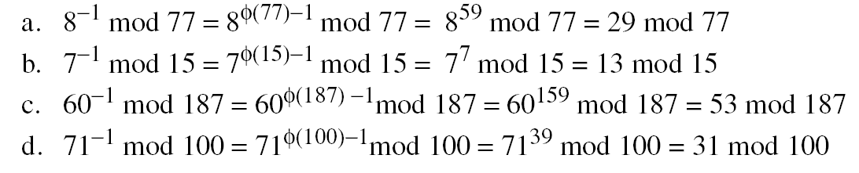
9.1.5 Continued
Example 9.17
The answers to multiplicative inverses modulo a composite can be found without using the extended Euclidean algorithm if we know the factorization of the composite:

Slide 27
9.1.7 Generating Primes
Mersenne Primes
Note
A number in the form M_{p} = 2^{p} − 1 is called a Mersenne number and may or may not be a prime.

Slide 28

9.1.7 Continued
Fermat Primes
F₀ = 3 F₁ = 5 F₂ = 17 F₃ = 257 F₄ = 65537
F₅ = 4294967297 = 641 × 6700417 Not a prime

Slide 29
9-2 PRIMALITY TESTING
Finding an algorithm to correctly and efficiently test a very large integer and output a prime or a composite has always been a challenge in number theory, and consequently in cryptography. However, recent developments look very promising.
Topics discussed in this section:
9.2.1 Deterministic Algorithms
9.2.2 Probabilistic Algorithms
9.2.3 Recommended Primality Test

Slide 30
9.2.1 Deterministic Algorithms
Divisibility Algorithm
Note
The bit-operation complexity of the divisibility test is exponential.

Slide 31
9.2.1 Continued
Example 9.18
Assume n has 200 bits. What is the number of bit operations needed to run the divisibility-test algorithm?
Solution
The bit-operation complexity of this algorithm is 2^{nb/2}. This means that the algorithm needs 2¹⁰⁰ bit operations. On a computer capable of doing 2³⁰ bit operations per second, the algorithm needs 2⁷⁰ seconds to do the testing (forever).

Slide 32

9.2.1 Continued
AKS Algorithm
Example 9.19
Assume n has 200 bits. What is the number of bit operations needed to run the AKS algorithm?
Solution
This algorithm needs only (log₂200)¹² = 39,547,615,483 bit operations. On a computer capable of doing 1 billion bit operations per second, the algorithm needs only 40 seconds.

Slide 33
9.2.2 Probabilistic Algorithms
Fermat Test
If n is a prime, a^{n−1} ≡ 1 mod n
If n is a composite, it is possible that a^{n−1} ≡ 1 mod n
Example 9.20
Does the number 561 pass the Fermat test?
Solution
Use base 2
The number passes the Fermat test, but it is not a prime, because 561 = 33 × 17.

Slide 34
9.2.2 Continued
Example 9.20
Does the number 561 pass the Fermat test?
Solution
Use base 2
The number passes the Fermat test, but it is not a prime, because 561 = 33 × 17.

Slide 35
9.2.2 Continued
Square Root Test
Example 9.21
What are the square roots of 1 mod n if n is 7 (a prime)?
Solution
The only square roots are 1 and −1. We can see that

Slide 36
9.2.2 Continued
Example 9.21
What are the square roots of 1 mod n if n is 7 (a prime)?
Solution
The only square roots are 1 and −1. We can see that
Note that we don’t have to test 4, 5 and 6 because 4 = –3 mod 7, 5 = –2 mod 7 and 6 = –1 mod 7.

Slide 37
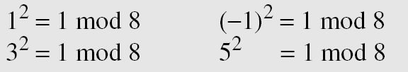
9.2.2 Continued
Example 9.22
What are the square roots of 1 mod n if n is 8 (a composite)?
Solution
There are four solutions: 1, 3, 5, and 7 (which is −1). We can see that

Slide 38
9.2.2 Continued
Example 9.23
What are the square roots of 1 mod n if n is 17 (a prime)?
Solution
There are only two solutions: 1 and −1

Slide 39
9.2.2 Continued
Example 9.24
What are the square roots of 1 mod n if n is 22 (a composite)?
Solution
Surprisingly, there are only two solutions, +1 and −1, although 22 is a composite.

Slide 40
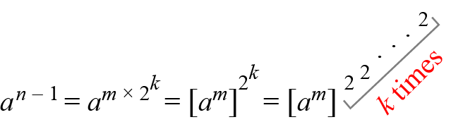
9.2.2 Continued
Miller-Rabin Test
Figure 9.2 Idea behind Fermat primality test
Note
The Miller-Rabin test needs from step 0 to step k − 1.

Slide 41
9.2.2 Continued

Slide 42
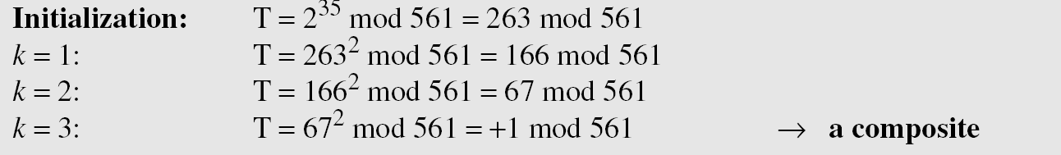
9.2.2 Continued
Example 9.25
Does the number 561 pass the Miller-Rabin test?
Solution
Using base 2, let 561 − 1 = 35 × 2⁴, which means m = 35, k = 4, and a = 2.

Slide 43
9.2.2 Continued
Example 9.26
We already know that 27 is not a prime. Let us apply the Miller-Rabin test.
Solution
With base 2, let 27 − 1 = 13 × 2¹, which means that m = 13, k = 1, and a = 2. In this case, because k − 1 = 0, we should do only the initialization step: T = 2¹³ mod 27 = 11 mod 27. However, because the algorithm never enters the loop, it returns a composite.

Slide 44
9.2.2 Continued
Example 9.27
We know that 61 is a prime, let us see if it passes the Miller-Rabin test.
Solution
We use base 2.

Slide 45
9.2.3 Recommended Primality Test
Today, one of the most popular primality test is a combination of the divisibility test and the Miller-Rabin test.

Slide 46
9.2.3 Continued
Example 9.28
The number 4033 is a composite (37 × 109). Does it pass the recommended primality test?
Solution
1. Perform the divisibility tests first. The numbers 2, 3, 5, 7, 11, 17, and 23 are not divisors of 4033.
2. Perform the Miller-Rabin test with a base of 2, 4033 − 1 = 63 × 26, which means m is 63 and k is 6.

Slide 47
9.2.3 Continued
Example 9.28
Continued
3. But we are not satisfied. We continue with another base, 3.

Slide 48
9-3 FACTORIZATION
Factorization has been the subject of continuous research in the past; such research is likely to continue in the future. Factorization plays a very important role in the security of several public-key cryptosystems (see Chapter 10).
Topics discussed in this section:
9.3.1 Fundamental Theorem of Arithmetic
9.3.2 Factorization Methods
9.3.3 Fermat Method
9.3.4 Pollard p – 1 Method
9.3.5 Pollard rho Method
9.3.6 More Efficient Methods

Slide 49

9.3.1 Fundamental Theorem of Arithmetic
Greatest Common Divisor
Least Common Multiplier

Slide 50
9.3.2 Factorization Methods
Trial Division Method

Slide 51
9.3.2 Continued
Example 9.29
Use the trial division algorithm to find the factors of 1233.
Solution
We run a program based on the algorithm and get the following result.
Example 9.30
Use the trial division algorithm to find the factors of 1523357784.
Solution
We run a program based on the algorithm and get the following result.

Slide 52
9.3.3 Fermat Method

Slide 53
9.3.4 Pollard p – 1 Method

Slide 54
9.3.4 Continued
Example 9.31
Use the Pollard p − 1 method to find a factor of 57247159 with the bound B = 8.
Solution
We run a program based on the algorithm and find that p = 421. As a matter of fact 57247159 = 421 × 135979. Note that 421 is a prime and p − 1 has no factor greater than 8
421 − 1 = 2² × 3 × 5 × 7

Slide 55
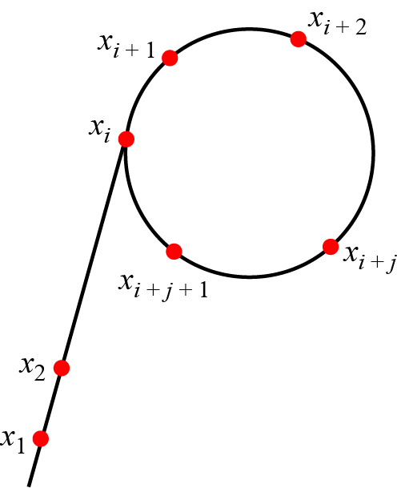
9.3.5 Pollard rho Method
Figure 9.3 Pollard rho successive numbers

Slide 56
9.3.5 Continued

Slide 57
9.3.5 Continued
Example 9.32
Assume that there is a computer that can perform 2³⁰ (almost 1 billion) bit operations per second. What is the approximation time required to factor an integer of size
a. 60 decimal digits? b. 100 decimal digits?
Solution
A number of 60 decimal digits has almost 200 bits. The complexity is then or 2⁵⁰. With 2³⁰ operations per second, the algorithm can be computed in 2²⁰ seconds, or almost 12 days.
b. A number of 100 decimal digits has almost 300 bits. The complexity is 2⁷⁵. With 2³⁰ operations per second, the algorithm can be computed in 2⁴⁵ seconds, many years.

Slide 58
9.3.5 Continued
Example 9.33
We have written a program to calculate the factors of 434617. The result is 709 (434617 = 709 × 613).

Slide 59
9.3.6 More Efficient Methods
Quadratic Sieve
The method uses a sieving procedure to find the value of x² mod n.
O(e^{C}), where C ≈ (ln n lnln n)^{1/2}
Number Field Sieve
The method uses a sieving procedure in an algebraic ring structure to find x² ≡ y² mod n.
O(e^{C}) where C ≈ 2 (ln n)^{1/3} (lnln n)^{2/3}

Slide 60
9.3.6 Continued
Example 9.34
Assume that there is a computer that can perform 230 (almost 1 billion) bit operations per second. What is the approximate time required for this computer to factor an integer of 100 decimal digits using one of the following methods?
a. Quadratic sieve method b. Number field sieve method
Solution
A number with 100 decimal digits has almost 300 bits (n = 2³⁰⁰). ln(2³⁰⁰) = 207 and lnln (2³⁰⁰) = 5.
a. (207)^{1/2} × (5)^{1/2} = 14 × 2.23 ≈ 32 e³² (e³²) / (2³⁰) ≈ 20 hours.
b. (207)^{1/3}× (5)^{2/2} = 6 × 3 ≈ 18. e¹⁸ (e¹⁸) / (2³⁰) ≈ 6 seconds.

Slide 61
9-4 CHINESE REMAINDER THEOREM
The Chinese remainder theorem (CRT) is used to solve a set of congruent equations with one variable but different moduli, which are relatively prime, as shown
below:

Slide 62
9-4 Continued
Example 9.35
The following is an example of a set of equations with different moduli:
The solution to this set of equations is given in the next section; for the moment, note that the answer to this set of equations is x = 23. This value satisfies all equations: 23 ≡ 2 (mod 3), 23 ≡ 3 (mod 5), and 23 ≡ 2 (mod 7).

Slide 63
9-4 Continued
Solution To Chinese Remainder Theorem
1. Find M = m₁ × m₂ × … × m_{k}. This is the common modulus.
2. Find M₁ = M/m₁, M₂ = M/m₂, …, M_{k} = M/m_{k}.
3. Find the multiplicative inverse of M₁, M₂, …, M_{k} using the corresponding moduli (m₁, m₂, …, m_{k}). Call the inverses M₁⁻¹, M₂⁻¹, …, M_{k} ⁻¹.
4. The solution to the simultaneous equations is

Slide 64
9-4 Continued
Example 9.36
Find the solution to the simultaneous equations:
Solution We follow the four steps.
1. M = 3 × 5 × 7 = 105
2. M₁ = 105 / 3 = 35, M₂ = 105 / 5 = 21, M₃ = 105 / 7 = 15
3. The inverses are M₁⁻¹ = 2, M₂⁻¹ = 1, M₃ ⁻¹ = 1
4. x = (2 × 35 × 2 + 3 × 21 × 1 + 2 × 15 × 1) mod 105 = 23 mod 105

Slide 65
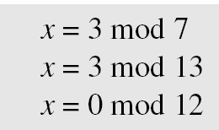
9-4 Continued
Example 9.37
Find an integer that has a remainder of 3 when divided by 7 and 13, but is divisible by 12.
Solution This is a CRT problem. We can form three equations and solve them to find the value of x.
If we follow the four steps, we find x = 276. We can check that 276 = 3 mod 7, 276 = 3 mod 13 and 276 is divisible by 12 (the quotient is 23 and the remainder is zero).

Slide 66
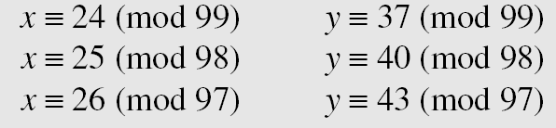
9-4 Continued
Example 9.38
Assume we need to calculate z = x + y where x = 123 and y = 334, but our system accepts only numbers less than 100.
Adding each congruence in x with the corresponding congruence in y gives
Now three equations can be solved using the Chinese remainder theorem to find z. One of the acceptable answers is z = 457.

Slide 67
9-5 QUADRATIC CONGRUENCE
In cryptography, we also need to discuss quadratic congruence⎯that is, equations of the form a₂x² + a₁x + a₀ ≡ 0 (mod n). We limit our discussion to quadratic equations in which a₂ = 1 and a₁ = 0, that is equations of the form
Cable companies are now competing with telephone companies for the residential customer who wants high-speed data transfer. In this section, we briefly discuss this technology.
x² ≡ a (mod n).
Topics discussed in this section:
9.5.1 Quadratic Congruence Modulo a Prime
9.5.2 Quadratic Congruence Modulo a Composite

Slide 68
9.5.1 Quadratic Congruence Modulo a Prime
We first consider the case in which the modulus is a prime.
Example 9.39
The equation x² ≡ 3 (mod 11) has two solutions, x ≡ 5 (mod 11) and x ≡ −5 (mod 11). But note that −5 ≡ 6 (mod 11), so the solutions are actually 5 and 6. Also note that these two solutions are incongruent.
Example 9.40
The equation x² ≡ 2 (mod 11) has no solution. No integer x can be found such that its square is 2 mod 11.

Slide 69
9.5.1 Continued
Quadratic Residues and Nonresidue
In the equation x² ≡ a (mod p), a is called a quadratic residue (QR) if the equation has two solutions; a is called quadratic nonresidue (QNR) if the equation has no solutions.

Slide 70
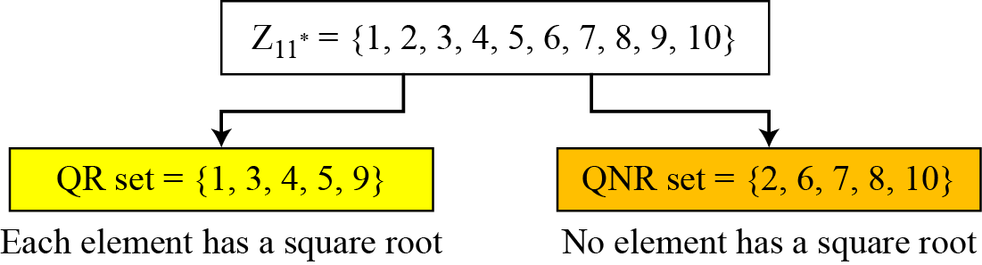
9.5.1 Continued
Example 9.41
There are 10 elements in Z₁₁*. Exactly five of them are quadratic residues and five of them are nonresidues. In other words, Z₁₁* is divided into two separate sets, QR and QNR, as shown in Figure 9.4.
Figure 9.4 Division of Z₁₁* elements into QRs and QNRs

Slide 71
9.5.1 Continued
Euler’s Criterion
a. If a^{(p−1)/2} ≡ 1 (mod p), a is a quadratic residue modulo p.
b. If a^{(p−1)/2} ≡ −1 (mod p), a is a quadratic nonresidue modulo p.
Example 9.42
To find out if 14 or 16 is a QR in Z₂₃*, we calculate:
14 ^{(23−1)/2} mod 23 → 22 mod 23 → −1 mod 23 nonresidue
16 ^{(23−1)/2} mod 23 → 16¹¹ mod 23→ 1 mod 23 residue

Slide 72
9.5.1 Continued
Solving Quadratic Equation Modulo a Prime
Special Case: p = 4k + 3

Slide 73
9.5.1 Continued
Example 9.43
Solve the following quadratic equations:
Solutions
x ≡ ± 16 (mod 23) √3 ≡ ± 16 (mod 23).
b. There is no solution for √2 in Z11.
c. x ≡ ± 11 (mod 19). √7 ≡ ± 11 (mod 19).

Slide 74
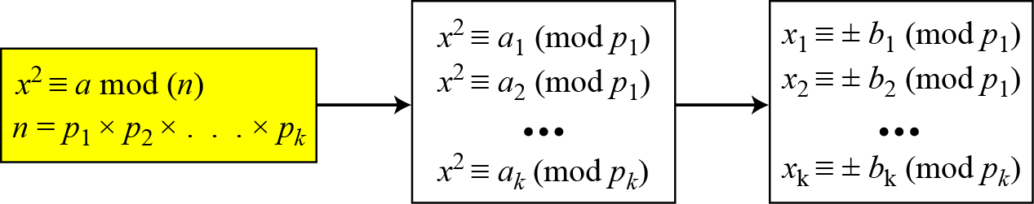
9.5.2 Quadratic Congruence Modulo a Composite
Figure 9.5 Decomposition of congruence modulo a composite

Slide 75
9.5.2 Continued
Example 9.44
Assume that x² ≡ 36 (mod 77). We know that 77 = 7 × 11. We can write
The answers are x ≡ +1 (mod 7), x ≡ − 1 (mod 7), x ≡ + 5 (mod 11), and x ≡ − 5 (mod 11). Now we can make four sets of equations out of these:
The answers are x = ± 6 and ± 27.

Slide 76
9.5.2 Continued
Complexity
How hard is it to solve a quadratic congruence modulo a composite? The main task is the factorization of the modulus. In other words, the complexity of solving a quadratic congruence modulo a composite is the same as factorizing a composite integer. As we have seen, if n is very large, factorization is infeasible.
Note
Solving a quadratic congruence modulo a composite is as hard as factorization
of the modulus.

Slide 77
9-6 EXPONENTIATION AND LOGARITHM
Topics discussed in this section:
9.6.1 Exponentiation
9.6.2 Logarithm

Slide 78
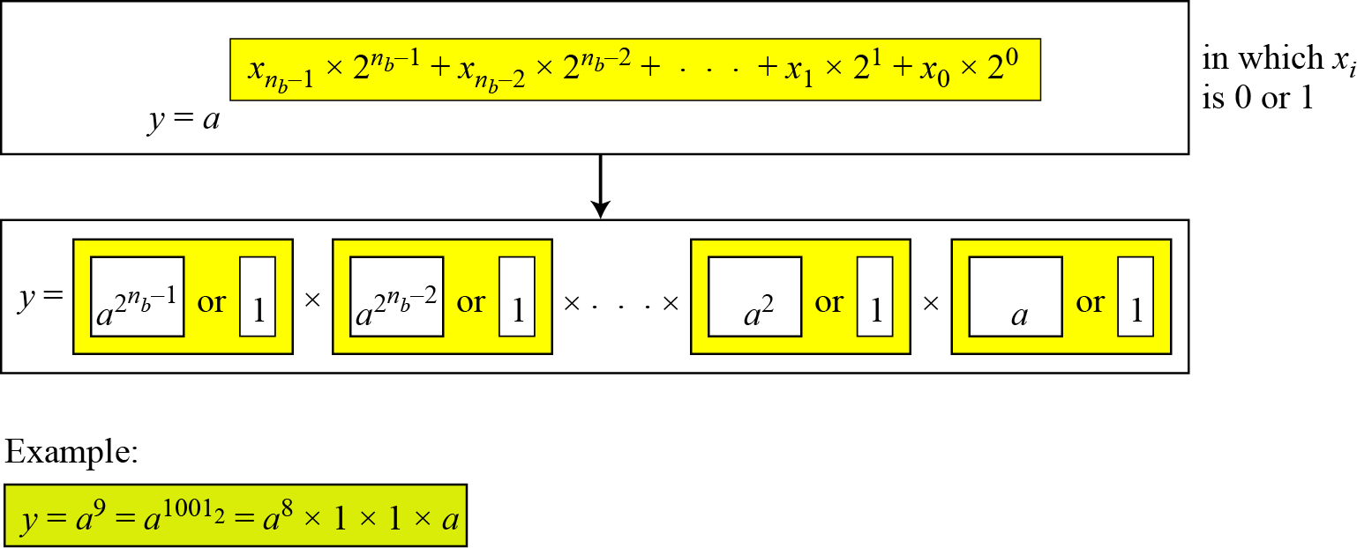
9.6.1 Exponentiation
Fast Exponentiation
Figure 9.6 The idea behind the square-and-multiply method

Slide 79
9.6.1 Continued

Slide 80
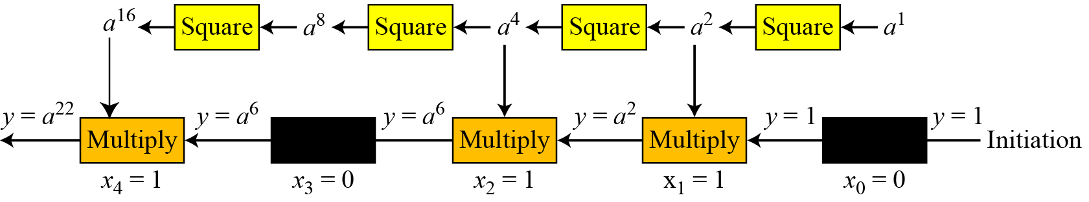
9.6.1 Continued
Example 9.45
Figure 9.7 shows the process for calculating y = a^{x} using the Algorithm 9.7 (for simplicity, the modulus is not shown). In this case, x = 22 = (10110)2 in binary. The exponent has five bits.
Figure 9.7 Demonstration of calculation of a²² using square-and-multiply method

Slide 81
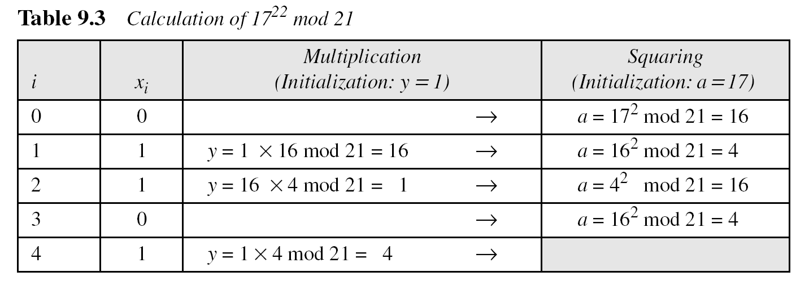
9.6.1 Continued
How about 21²⁴ mod 8?

Slide 82
9.6.2 Logarithm
In cryptography, we also need to discuss modular logarithm.
Exhaustive Search

Slide 83
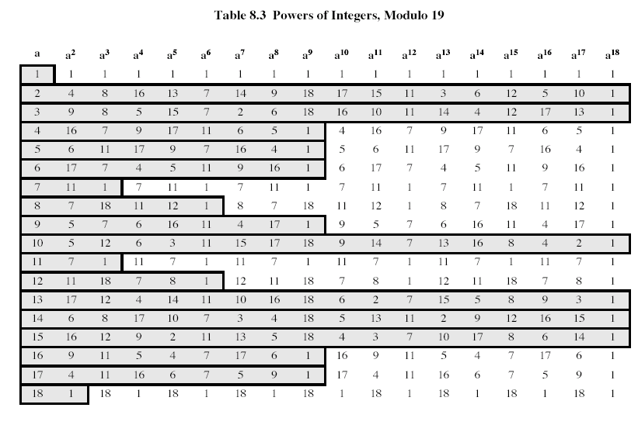

Slide 84
9.6.2 Continued
Order of the Group.
Example 9.46
What is the order of group G = <Z₂₁∗, ×>? |G| = φ(21) = φ(3) × φ(7) = 2 × 6 =12. There are 12 elements in this group: 1, 2, 4, 5, 8, 10, 11, 13, 16, 17, 19, and 20. All are relatively prime with 21.

Slide 85
9.6.2 Continued
Order of an Element
Example 9.47
Find the order of all elements in G = <Z₁₀∗, ×>.
Solution
This group has only φ(10) = 4 elements: 1, 3, 7, 9. We can find the order of each element by trial and error.
a. 1¹ ≡ 1 mod (10) → ord(1) = 1.
b. 3⁴ ≡ 1 mod (10) → ord(3) = 4.
c. 7⁴ ≡ 1 mod (10) → ord(7) = 4.
d. 9² ≡ 1 mod (10) → ord(9) = 2.

Slide 86
9.6.2 Continued
Euler’s Theorem
Example 9.48

Slide 87
9.6.2 Continued
Primitive Roots In the group G = <Z_{n}∗, ×>, when the order of an element is the same as φ(n), that element is called the primitive root of the group.
Example 9.49
Table 9.4 shows that there are no primitive roots in G = <Z₈∗, ×> because no element has the order equal to φ(8) = 4. The order of elements are all smaller than 4.

Slide 88
9.6.2 Continued
Example 9.50
Table 9.5 shows the result of a^{i} ≡ x (mod 7) for the group G = <Z₇∗, ×>. In this group, φ(7) = 6.

Slide 89
9.6.2 Continued
Note
The group G = <Z_{n}*, ×> has primitive roots only if n is 2, 4, p^{t}, or 2p^{t}.
Example 9.51
For which value of n, does the group G = <Z_{n}∗, ×> have primitive roots: 17, 20, 38, and 50?
Solution
G = <Z₁₇∗, ×> has primitive roots, 17 is a prime.
b. G = <Z₂₀∗, ×> has no primitive roots.
c. G = <Z₃₈∗, ×> has primitive roots, 38 = 2 × 19 prime.
d. G = <Z₅₀∗, ×> has primitive roots, 50 = 2 × 5² and 5 is a prime.

Slide 90
9.6.2 Continued
Note
If the group G = <Z_{n}*, ×> has any primitive root, the number of primitive roots is φ(φ(n)).

Slide 91
9.6.2 Continued
Cyclic Group If g is a primitive root in the group, we can generate the set Z_{n}* as Z_{n}∗ = {g¹, g², g³, …, g^{φ(n)}}
Example 9.52
The group G = <Z₁₀*, ×> has two primitive roots because φ(10) = 4 and φ(φ(10)) = 2. It can be found that the primitive roots are 3 and 7. The following shows how we can create the whole set Z₁₀* using each primitive root.

Slide 92
9.6.2 Continued
The idea of Discrete Logarithm
Properties of G = <Z_{p}*, ×> :
1. Its elements include all integers from 1 to p − 1.
2. It always has primitive roots.
3. It is cyclic. The elements can be created using g^{x} where x is an integer from 1 to φ(n) = p − 1.
4. The primitive roots can be thought as the base of logarithm.

Slide 93
9.6.2 Continued
Solution to Modular Logarithm Using Discrete Logs
Tabulation of Discrete Logarithms

Slide 94
9.6.2 Continued
Example 9.53
Find x in each of the following cases:
a. 4 ≡ 3^{x} (mod 7).
b. 6 ≡ 5^{x} (mod 7).
Solution
We can easily use the tabulation of the discrete logarithm in Table 9.6.
a. 4 ≡ 3^{x} mod 7 → x = L₃4 mod 7 = 4 mod 7
b. 6 ≡ 5^{x} mod 7 → x = L₅6 mod 7 = 3 mod 7

Slide 95
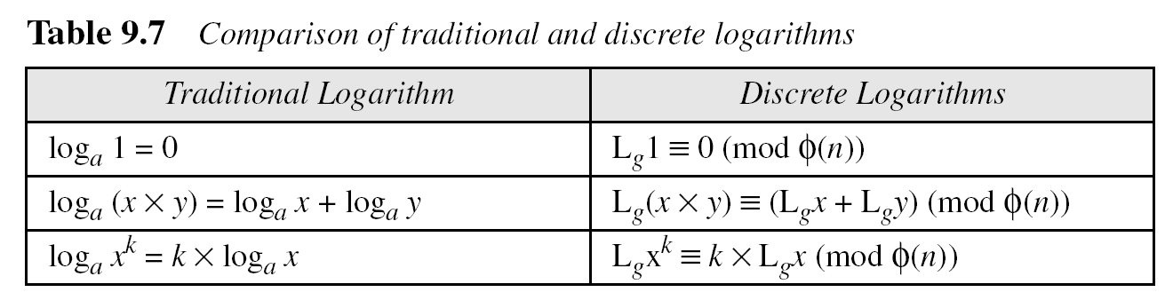
9.6.2 Continued
Using Properties of Discrete Logarithms
Using Algorithms Based on Discrete
Note
The discrete logarithm problem has the same complexity as the factorization problem.

Slide 96

Summary
1. Euclid’s tabular method allows finding gcd and inverses
2. Group is a set of element and an operation that satisfies closure, associativity, identity, and inverses
3. Abelian group: Operation is commutative
4. Rings have two operations: addition and multiplication
5. Fields: Commutative rings that have multiplicative identity and inverses
6. Finite Fields or Galois Fields have elements where p is prime
7. Polynomials with coefficients in GF(2n) also form a field.
Notes:
96
Chapter 4 summary.

Slide 97
Test your understanding
Briefly define a group.
Briefly define a ring.
Briefly define a field.
What does it mean to say that b is a divisor of a?
What is the difference between modular arithmetic and ordinary arithmetic?
List three classes of polynomial arithmetic.

Slide 98
References
1. William Stallings, Cryptography and Network Security, 6th Edition, Pearson Education, March 2013.
2. Charlie Kaufman, Radia Perlman and Mike Speciner, “Network Security”, Prentice Hall of India, 2002.

